Slide 1
2021 MLP team meeting 04.02
Yonsei University
Machine Learning Project Team 09
Hyeonwoo Lee

Slide 2
RAWSim-O (Check)
Tutorial
Setup
Simulation
Instance
Etc
Implementing Controller
Youtube
Modified test controller → Uploaded on Github

Slide 3
Proposal – Time window
VRPTW (Typical problem)
Great method to find optimal solution of VRP
Already done → State-of-art
Easy to Simulation (Add time window rule in RAWSim-O)
Paper
Solving Large-Scale VRP with Time windows
Brainstorming-Based Ant Colony Optimization for Vehicle Routing With Soft Time Windows
An Optimization-Based Heuristic for Vehicle Routing and Scheduling with Soft Time Window Constraints
참고)
Google OR-Tools
https://developers.google.com/optimization/routing/vrptw
Multi –depot-VRP
https://github.com/graphhopper/jsprit/blob/master/docs/Multiple-Depot-VRP.md

Slide 4
Proposal – Adverserial agent
Adversiral agent -- RL
Deep RL base
papers
https://github.com/HumanCompatibleAI/adversarial-policies
Agent
Unoptimized mobile robot (Urgent situation)
Simple adverse agnet
How to simulation?
RL?
W/O RL ? (Only add adeverial agent)
Rule base controller

Slide 5
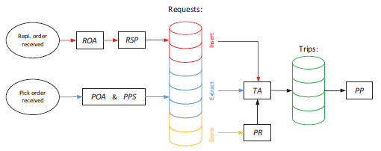
Proposal – Descion rule
Descion rule modification
ROA & RSP
Split it as RSP after ROA
Merge POA and PPS together
Related papers
Lin Xie, Introducing split orders and optimizing operational policies in RMFS
How to apply to our project? (Future work)

Slide 6
Proposal – Pod classification
Classification along the..
Frequency or Importance
Arrange items
Find optimal arrangement
Using Classfication algorithm with proper weight
Dependency
Ex) Korean food such as 보쌈
Includes meats, vegetables etc.
We can make them arrange together
Find the specific dataset from Kaggle or somewhere

